Slide 1


SECURE SOFTWARE DEVELOPMENT (SSD)
Diploma in CSF
Academic Year (AY) 20/21 – Semester 3 (April `20)
Week 15
Learning guidance
Last Updated: 13/07/2020

Slide 2
Contents
Gentle Reminder – SSD Practical Test
Learning Guidance for Week 15

Slide 3
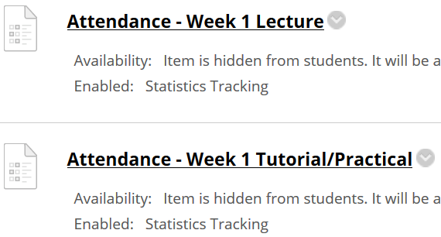
Important Details
VERY IMPORTANT
Visit MEL to start each week’s lesson. Learning materials will ONLY be released in MEL
Attendance Poll Attempt TWO attendance polls every week Starts Monday (9am) till Friday (11:59pm) Attendance :– Week x Lecture ( x refers to week number) Week x Tutorial/Practical Just click “Save and Submit”
Always lookout for announcements Do keep abreast of announcements in MEL
In light of the Covid-19 situation, your cooperation in adhering to the points mentioned is much needed and greatly appreciated.

Slide 4
Learning Guidance for Week 15
Notes
No new concepts in week 15 because week 13 slides (Secure Testing) span across week 15 & 16.
However, the following are guidance for students to conduct learning in Week 15.
Step 1 (Revise Week 12 slides)
In view of practical test this week, students are encouraged to revise Week 12 lesson.
Students are advised to have laptops ready for the practical. Ensure either SSD VM or Mutillidae web application is running in the laptop. Refer to Week 12 slides for details.
Step 2 (Complete Week 13 slides on Secure Testing)
Students to complete Week 13 slides on Secure Testing, if you have not done so.
Continue to do SSD Assignment
Step 3 (Complete HBL Survey)
Students to complete HBL Survey, if you have not done so.

Slide 5
Gentle Reminder – SSD Practical Test
Please note that SSD Practical Test will be conducted this week (Week 15).
Details as follow:-
Date: 30th July 2020 (Thursday)
Time: 4pm-6pm
Venue: SSD-AY2021-ALL-TEAM (Microsoft Teams)

